Slide 1

Rockbuster Stealth Data
Shirwet Elfeel
2023

Slide 2
Introduction
Current situation
Rockbuster Stealth LLC is a movie rental company that used to have stores around the world. Facing stiff competition from streaming services such as Netflix and Amazon Prime
Future situation
The Rockbuster Stealth management team is planning to use its existing movie licenses to launch an online video rental service in order to stay competitive.

Slide 3
Key Questions
Which movies contributed the most/least to revenue gain?
What was the average rental duration for all videos?
Which countries are Rockbuster customers based in?
Where are customers with a high lifetime value based?
Do sales figures vary between geographic regions?

Slide 4
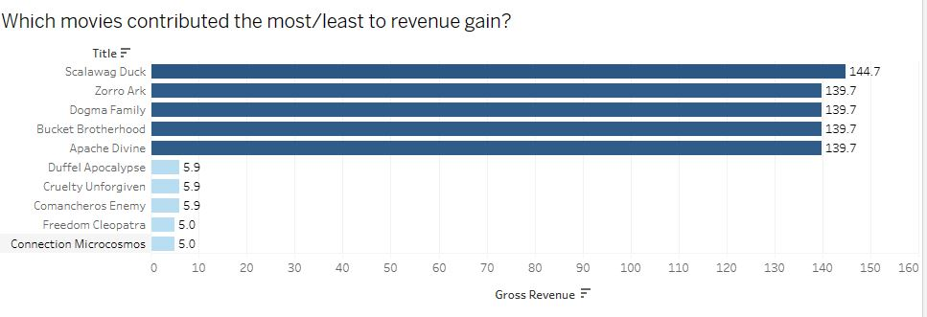
The most/least 5 movies based on revenue

Slide 5
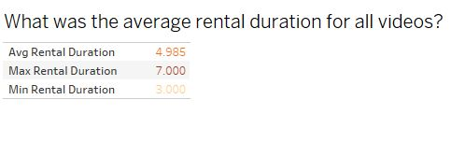
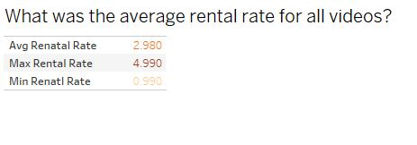
People average rent is 5 days while maximum is 7 days.

Slide 6
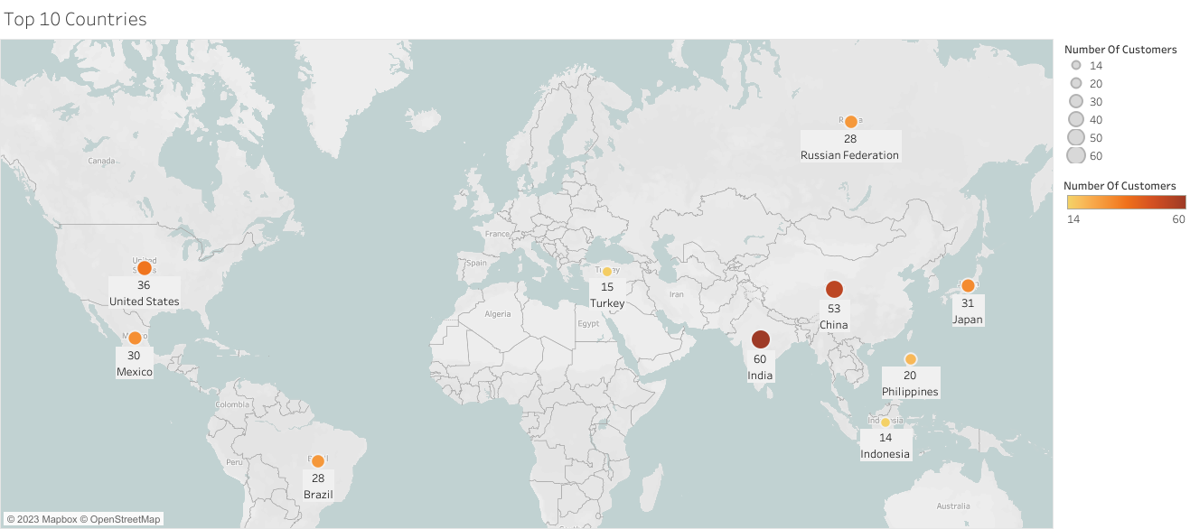
Which countries are Rockbuster customers based in?
This map is showing the top 10 countries with the most Rockbuster customers. We can see that India, China, and the United States are the top 3 countries in terms of customer count and going back to our top 10 spending countries, the order to the top is the exact same.

Slide 7
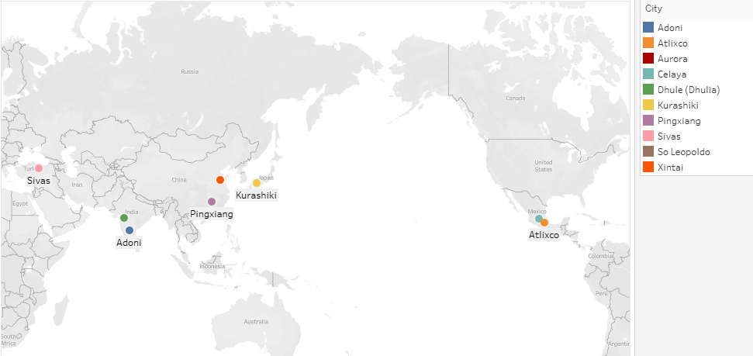
Where are customers with a high lifetime value based?
It can be used to send coupons or create a reward program for high lifetime customers.

Slide 8
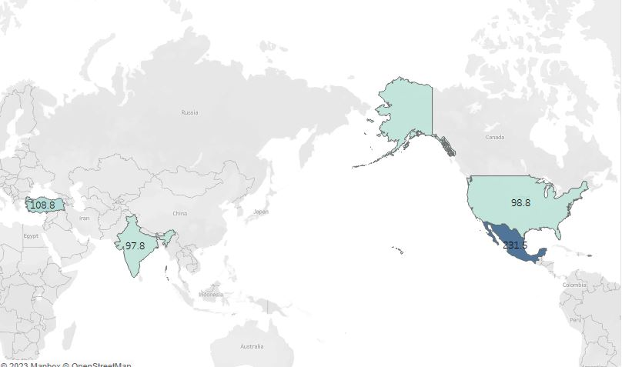
Do sales figures vary between geographic regions?
Sales figures are high in Turkey, USA, India and Mexico, which helps understanding that the focus has to be on these countries.

Slide 9
Recommendations
The investment for online streaming should be focused on the top countries like USA, India, Mexico, Turkey, China.
Focus on the highest sales movies or marketing like Juggler Hardly, Scalawag Duck etc. and see which category they are in.
Ask the top five customers for their review to see what drive the business in exchange to a reward like coupons or month free option etc.

Slide 10
Questions
?

